Slide 1
Classifying Recipe to increase Site Traffic
A solution for Zesty Bytes by Khaleed Oyeleke
12/04/2023
Notes:
Hi team
I am khaleed oyeleke from the data science team and i will walk you through the solution we propose for Classifying Recipe to increase Site Traffic

Slide 2
Business Goals
To Increase Website Traffic: Utilize data science capabilities to identify and feature recipes on the homepage that are most likely to increase overall website traffic by up to 40%.
Business Requirement(KPI): Develop a model that can accurately predict high-traffic recipes with at least 80% precision threshold to enhance the effectiveness of homepage content selection and drive more subscriptions.
Actionable Insights for Strategy: Provide recommendations and strategic next steps based on the model’s findings to inform content curation and decision-making processes.
Notes:
To iterate, these are our business goals
1
2
3

Slide 3
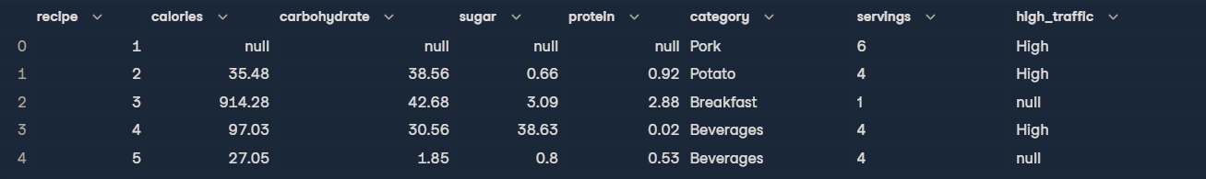
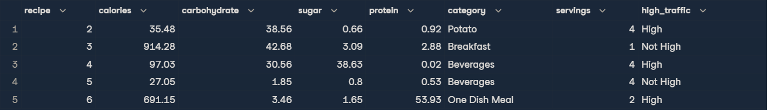
Data
Data for each recipe, as well as whether there was high traffic when the recipe was on the home page.
Notes:
This is the data pulled from the website. Its about categories of recipe, the serving size, their nutritional content and whether it lead to high traffic or not
The data was validated and some changes were made
Null data were dropped in some columns
Null data in high traffic was changed to not high to help us classify the data better

Slide 4
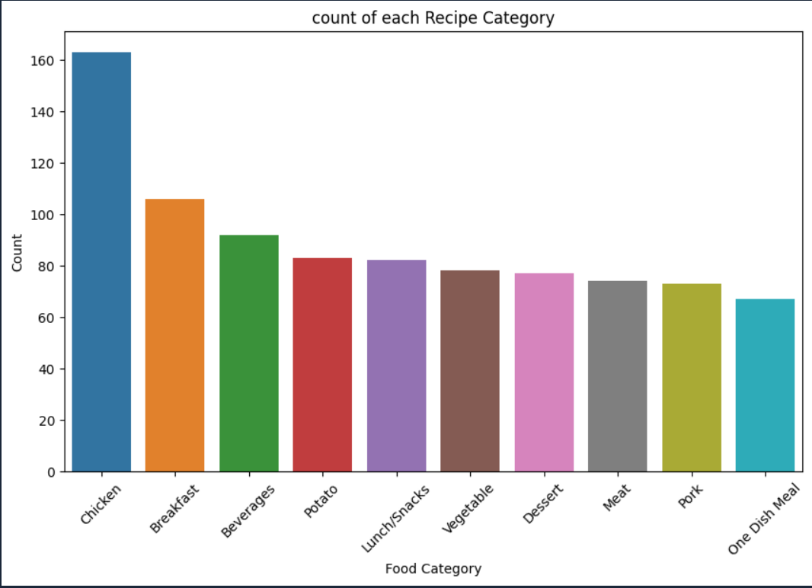
Key Findings
In this dataset, we have 10 categories of Recipes.
This is the total count for each recipe category. We can see Chicken recipe was served considerably the most.
Notes:
Onto our key findings
In the dataset we have 10 category, we looked into how many times each category was served on the website. …

Slide 5
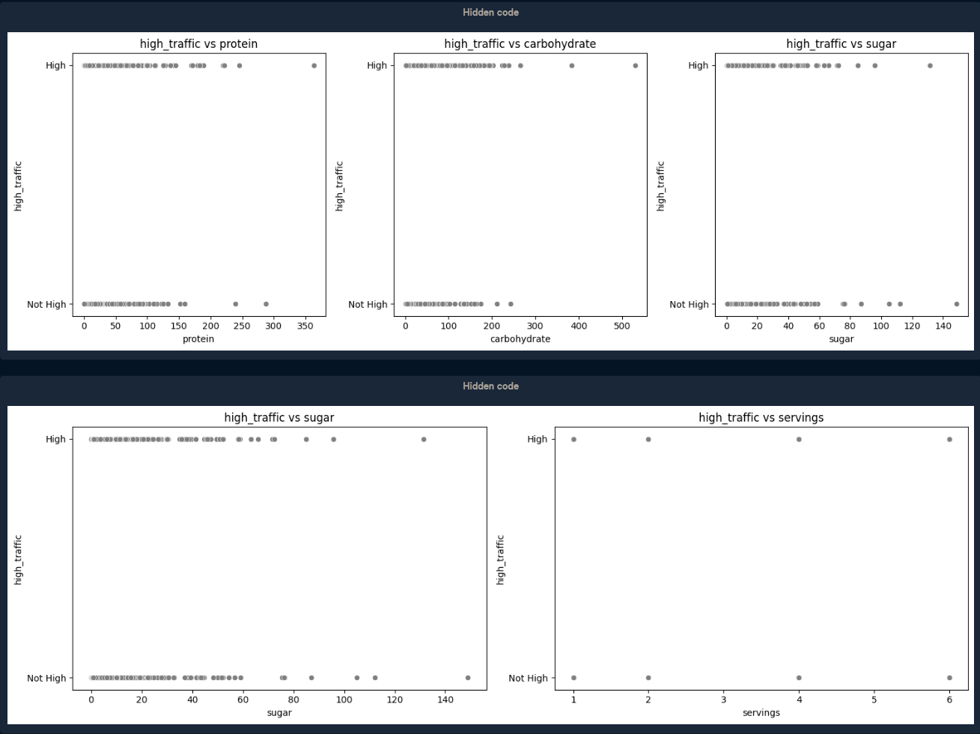
Key Findings
The relationship between the numeric columns and high traffic is a non-linear relationship.
Notes:
We found the relationship between the numeric columns and high traffic are non-linear
This would influence our model choices

Slide 6
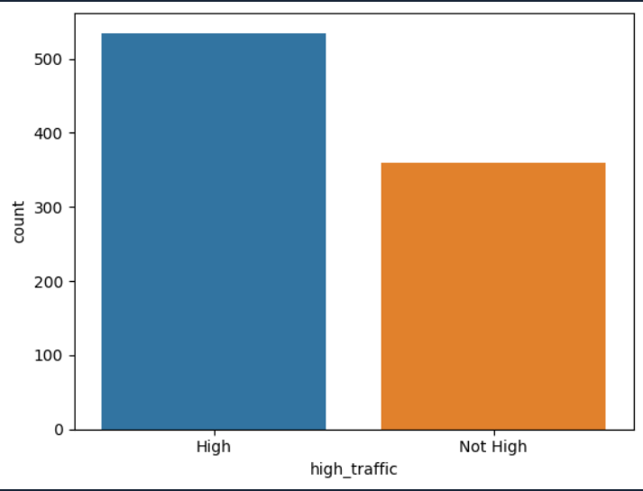
Key Findings
The count of High traffic to Not-high traffic.
High traffic recipes were considerable more than Not-high traffic recipes.
Notes:
The count of High traffic vs Not-high traffic
We can see an indicator of class imbalance here - we have more high traffic data than not high traffic data
We would put this into consideration when building our models
This would influence our model evaluation later on

Slide 7
Outcomes
Two Models - Logistic Regression and Random Forest Classifier to classify recipe into two groups as high traffic or Not and evaluate the results.
PRE-PROCESSING
Features
Carbohydrate
Calories
Sugar
Protein
Category
Servings
Target
High_traffic
Logistic Regression
Model
Classification 1
Evaluation 1
Random Forest Classifier Model
Classification 2
Evaluation 2
Notes:
After all the findings we were now ready to build our models. This business task requires classification machine learning models.
Firstly some Preprocessing steps to feed the data into the classification models e.g class imbalance in the high traffic column.
Then we split the data into 2
features - Features are characteristics of what we you want to classify/predict
target - you're trying to predict or understand
We used two models
Log Reg: light weight model that is easy to interpret, it does not work best with non-linear relationship like we have in our data but it would to serve as a benchmark for a more complex model.
Rf Classifier: complex model that can work non-linear relationship
We can get features importance from the model to let us know which of the features variable above have a great influence on a recipe being high traffic

Slide 8
Outcomes
Two evaluation metrics - Accuracy and Precision
Metrics | Accuracy | Precision
Purpose | Accuracy shows how often our recipe predictions are correct. The higher the better. | Precision tells us how many of the recipes we predicted as high traffic hits were actual hits. The higher the better.
Range | 1-100% | 1-100%
Notes:
We evaluated the models on two metrics.
Accuracy
Read the screen
Precision
Read the screen + This is most important to us as the product team said they want to make sure they are displaying high traffic recipes no matter what. Also remember we have class imbalance it is better we use precision.

Slide 9
Outcomes
Two evaluation metrics - Accuracy and Precision
Model | Accuracy | Precision
Logistic Regression | 78% | 83%
Random Forest Classifier | 78% | 82%
Notes:
These are our results
We can see the complex model RF performed great against our simpler model. The difference is 1% which is not a significant difference.
We are favouring random forest classifier for its performance and ability to understand non-linear relationship

Slide 10
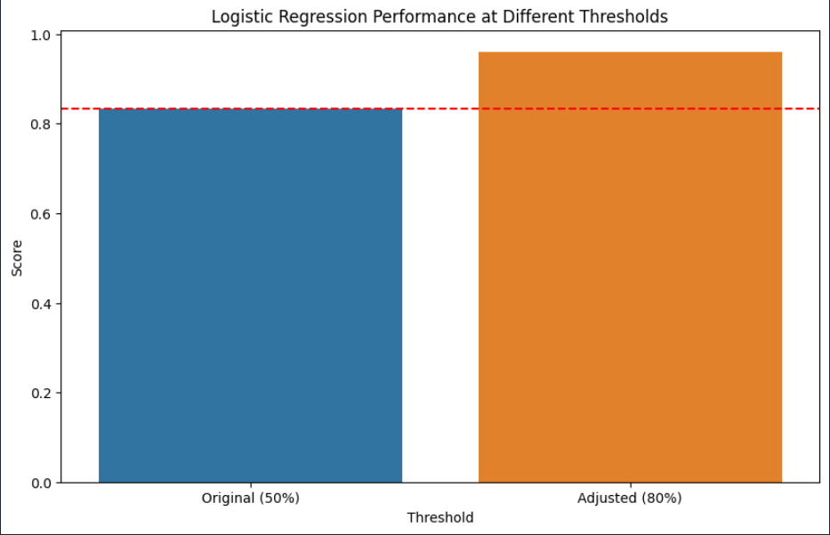
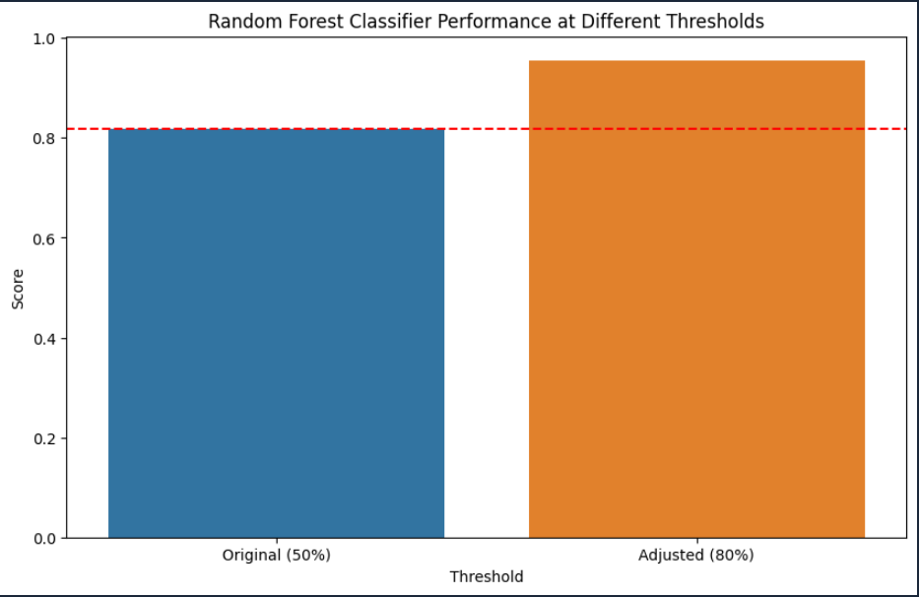
Outcomes
Business Requirement(KPI) - Correctly predict high traffic recipes 80% of the time
Notes:
To align with the product team's goal of showing high-traffic recipes at least 80% of the time, we have re-evaluated our models with an adjusted prediction probability threshold. By increasing the threshold from 50% to 80%, we aim to focus more on high-traffic predictions. This adjustment serves as a key performance indicator (KPI), enabling us to re-evaluate both models under these new criteria.
The KPI was added on the already built model and re-evaluated for their precision %

Slide 11
Outcomes
Business Requirement(KPI) - Correctly predict high traffic recipes 80% of the time
Model | Precision at threshold 50%(default) | Precision at threshold 80%(KPI)
Logistic regression | 83% | 96%
Random Forest Classifier | 82% | 96%
Notes:
We can see the complex model RF performed greatly against our simpler model here with the same precision score.
For this reason, RF CL is our preferred model for its performance and ability to understan non-linear relationship.

Slide 12
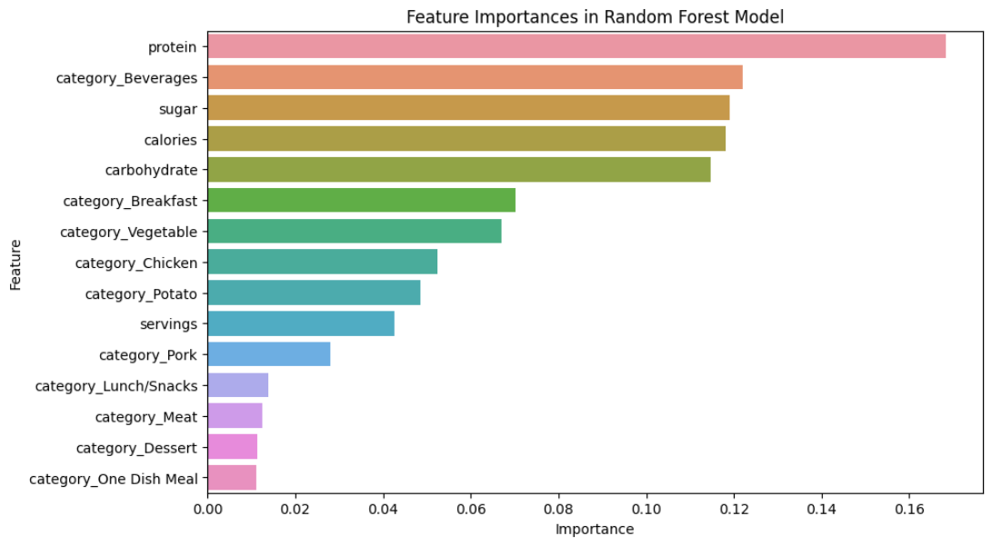
Outcomes
Feature importance in the Random Forest Classifier Model
These are the major indicators as to whether a Recipe would lead to high traffic.
Protein
Beverages Recipe
Sugar
Calories
Notes:
According to out RF model These are the major indicators as to whether a recipe would lead to high traffic.
These are the things in the high traffic food that makes consumers like them, their
Protein content
Beverages in general
Sugar content
Calories

Slide 13
Recommendation
1. I suggest A/B testing the model's recommendations in a real-world setting to further evaluate its effectiveness before full implementation. This can help fine-tune the model and adapt to the actual user behavior patterns.
2. Continuously improve the model by collecting more data, features engineering and fine tuning parameter. This would help us get over the limitation of small dataset, the more data and features we have the better the models we can build.
3. A higher threshold will increase our precision but will slightly reduce our accuracy score. The threshold of 80% should be monitored and review periodically.

Slide 14
THANK YOU
Notes:
THANK YOU FOR YOUR TIME

